Slide 1
International Business Development Program
Partnering with Clients for Global Innovation
EWMBA Info Session 10.24.19

Slide 2
What is IBD?
Management consulting elective course
International projects with real world clients
26+ years at Berkeley Haas
487
International Projects
1,735
MBA Students
89
Countries

Slide 3
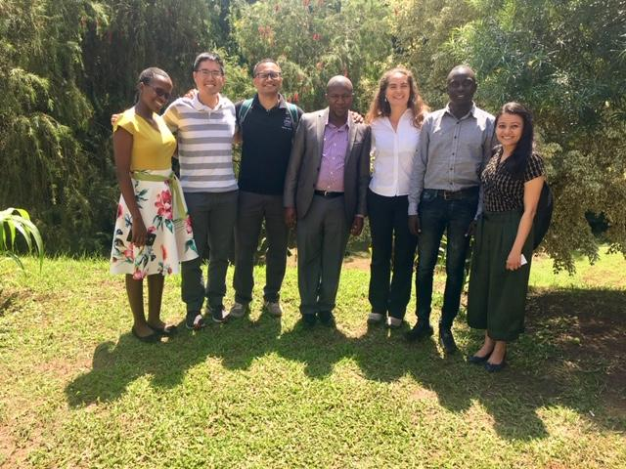
2019 EWMBA IBD Project Teams

Slide 4
By the end of the IBD course, you will have developed...
Cultural awareness
Consulting skillset
Team collaboration skills
Industry knowledge
Opportunity to apply core MBA classes

Slide 5
How does International Business Development (IBD) differ from Seminars in International Business (SIB)?
SIB
IBD
Broad overview of business culture in a country
Learning based on company visits and presentations
Greater focus on local corporations
Spring or Summer options
1 week in-country
2 units credit
Economical business hotels
You pay for flights, visas, immunizations, meals, and entertainment
Opportunities for 60 students per year (20 per trip)
You choose the trip you want
Deep understanding of one organization in a country
Learning based on tackling a project that poses a strategic business problem requiring a real-world solution
Greater focus on non-profits and social enterprises
Summer only for in-country period: Saturday, June 27 and Saturday, July 11 = in-country travel dates
2 weeks in-country
3 units credit
Can be more rustic living conditions
You pay for flights, visas, immunizations, meals, and entertainment
Opportunities for 15 students (3 project teams of 5 students each)

Slide 6
How do the IBD teams and projects work?

Slide 7
IBD handles many types of projects
Entrepreneurial Activities
Feasibility Studies
Sustainability Plans
Case Studies
Business Plans
Strategic Plans
Market Research
Financial Assessments
Notes:
Projects that IBD handles include:
Business Plans
Case Studies
Entrepreneurial Activities
Feasibility Studies
Financial Assessments
Market Research
Strategic Plans
Sustainability Plans

Slide 8
IBD works in many sectors
Agriculture
Healthcare
High Technology
Biotechnology
Financial Services
Hospitality
Conservation
Energy
Manufacturing
Ecotourism
Education
Retail

Slide 9
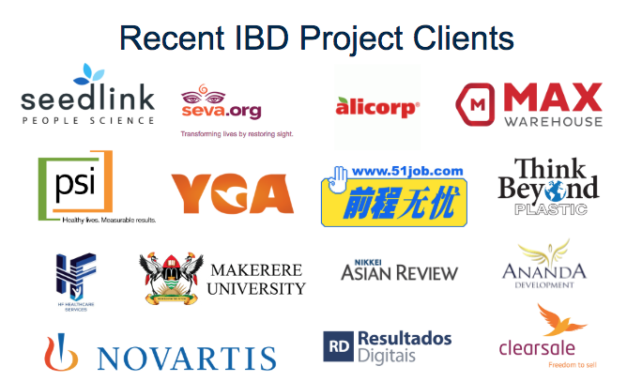
IBD works with many clients

Slide 10
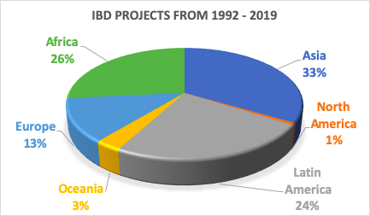
Where does IBD work?

Slide 11
How will I be assigned to a project team?
You will be assigned to:
A client project plus a Faculty Mentor
A consulting project that balances the client’s needs and your background

Slide 12
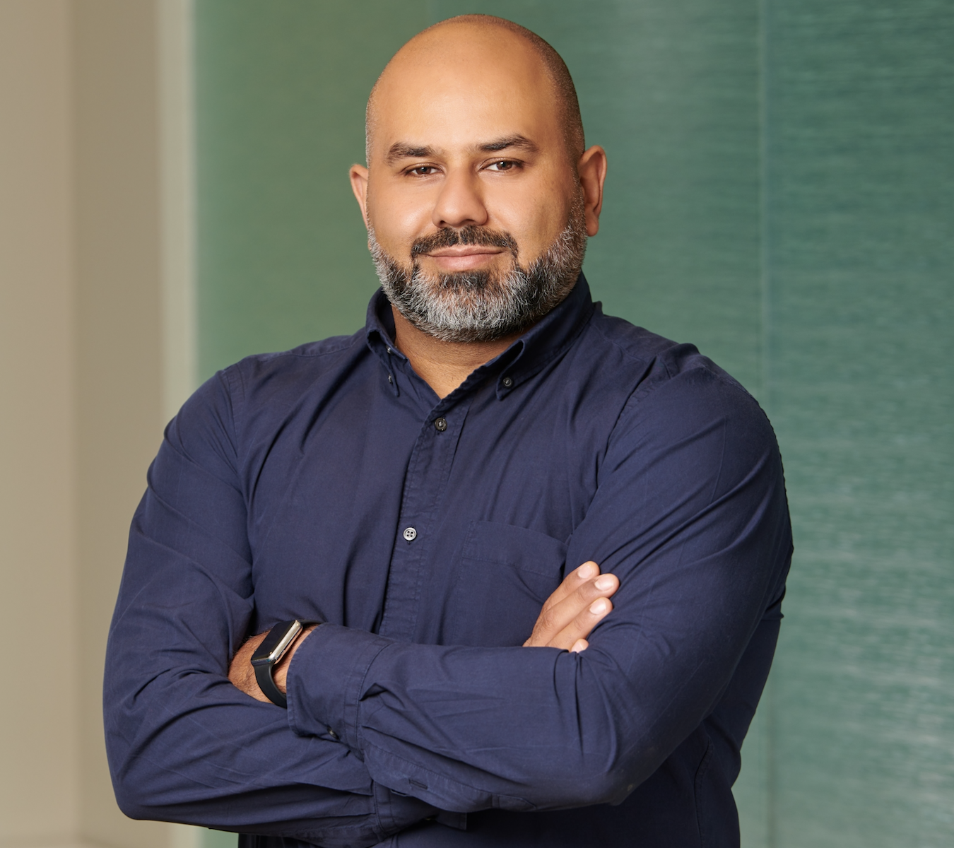
Berkeley Haas Faculty Mentor for your team
Arman Zand has more than 20 years of experience in technology and venture finance. He is currently Head of Finance at Farmstead, an AI-powered grocery delivery startup based in SF. Prior to joining Farmstead, Arman was with Quona Capital, a fintech venture capital fund focused on financial inclusion in emerging markets. Prior to joining Quona, Arman was Director of Business Development at RocketSpace, Inc. where he helped advise on corporate open innovation with Fortune 1000 brands. Arman spent the previous 15 years at Silicon Valley Bank in the US, India, U.K, the Middle East, and Asia, helping expand the SVB globally including 7 years in China where he helped co-found China's first joint venture technology bank. Arman is fluent in Mandarin Chinese and is a part-time professional faculty member at the Haas School of Business, UC Berkeley.
Arman Zand

Slide 13
Class will meet on 1 Sunday and 4 Saturdays
Date | Time
Sunday, May 17 | 1:00 pm - 5:00 pm
Saturday, May 30 | 10:30 am - 6:00 pm
Saturday, June 6 | 8:30 am - 6:00 pm
Saturday, June 13 | 8:30 am - 6:00 pm
Saturday, June 20 | 8:30 am - 6:00 pm
NO CLASS: May 23, 2020
NOTE: All Berkeley Haas classes are mandatory and required for a full grade.

Slide 14
If you participate, you must be able to…
Work in-country for 2 weeks
In-country travel dates: Saturday, June 27 and Saturday, July 11
In-country lodging and project-based ground transportation are covered by IBD
You are responsible for the cost of your flights to and from the country, meals, entertainment, visas, and immunizations
Participate in a half-day Annual IBD Conference at Berkeley Haas on Friday, September 11, 2020

Slide 15
Who are the best IBD candidates?
Flexible
Adventurous
Open minded
Hard working
Team oriented
Able to deal with ambiguity

Slide 16
What IBD is not…
A “vacation” to a foreign country

Slide 17
Do you want to bid?
Enrollment in IBD is capped at 15. If fewer than 15 students bid for this course in Spring 2020 Bidding, the course will be cancelled.
Bidding Round 1 10/28/19, 12:00pm – 11/1/19, 12:00pm
Bidding Round 2 11/1/19, 4:00pm – 11/6/19, 12:00pm
IBD has a strict NO DROP POLICY. Due to the nature of the coursework and working with real clients, students are required to be committed upon enrollment. Once you successfully bid into this course, there is no opportunity to drop.
Notes:
(Students notified of SIB, DS, and Washington Campus enrollment)

Slide 18
For more information…
Danner Doud-Martin
IBD Associate Director
F445
dannerdm@haas.berkeley.edu
Arman Zand
IBD Faculty Mentor
F502
armanzand@berkeley.edu

