Slide 1
International Student Guide
Data & Trends Report
August 2022

Slide 2
Companies and Sponsorship

Slide 3
Table of Contents
Where do international students go for their 1st post-MBA job?
How did they find their post-MBA job?
Where do international students go for their internship?
How did they find their Internship?
What opportunities are open to International students?
How to identify which companies are open to International students?
Sample employers who tend / tend NOT to sponsor and why?
*For the purpose of this guide, international students are defined as non-US citizens without permanent residence.

Slide 4
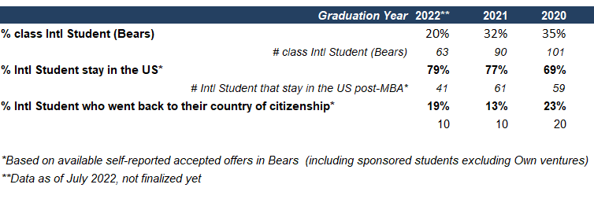
Where do international students go for their 1st post-MBA job?
More than 65% of international students who reported accepting a post-MBA job stayed in the US in the last 3 years.

Slide 5
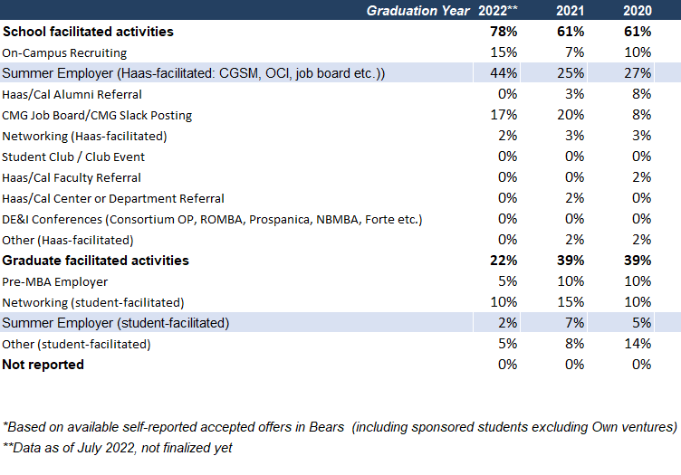
How did they find their post-MBA job in the US?
46% of international students who stayed in the US obtained their post-MBA job from
their summer internship for graduating class of 2022**.

Slide 6
Where do international students have the option to go in the US post-MBA?
The 49 offers made in 2022 to international students in the US spread across 31 companies reflecting the diversity of possibilities open to international MBA talent.
Employers who made 2 or more offers to International Haasis in the US in 2022:
Want to know more about offers made to international Haasies (in the US and outside the US)?

Slide 7
Where do international students go for their internship?
For the class of 2023 over 90% of international students who reported accepting an internship stayed in the US for their internship.

Slide 8
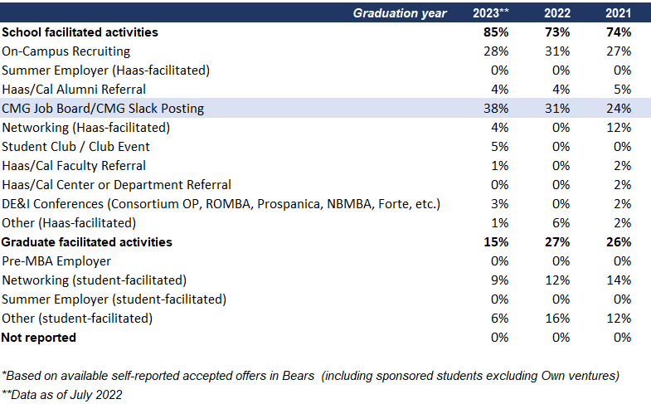
How did they find their Internship?
38% of international students who stayed in the US obtained their internship through CMG job posting: make sure to stay connected through CMG BEARS and Slack!

Slide 9
Where do international students go for their Internship?
The 91 internship offers made to international students in the US for class of 2023 spread across 66 companies reflecting the diversity of possibilities.
Employers who made 2 or more offers to International Haasis for class of 2022 internships:
Want to know more about offers made to international Haasies (in the US and outside the US)?

Slide 10
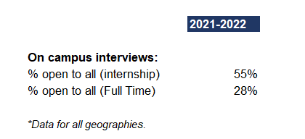
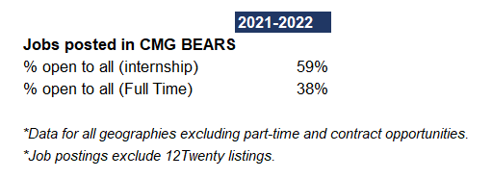
What opportunities are open to International students?
Want to know more about these opportunities?

Slide 11
Why Don’t More Companies Sponsor?
Supply and Demand factor for each function/role
The need to satisfy local industry/customer knowledge or meet government security clearance.
Increased risk due to the limited H1B slots and the lottery process
Lack of knowledge around the H1B process : especially for mid-smaller size companies
Concerns around long term commitment

Slide 12
Which Industry tend to Sponsor?
Tend to sponsor
Tend not to sponsor
Big Tech
Social Impact
Public markets investment funds, PE and VC firms
Consulting
Larger International Investment Banks
Energy
CPG
Startups
Design
Changes by company and sometimes by role!
Notes:
Larger companies with International offices such as Big Tech, IB > tend to sponsor
Industry that require specific knowledge tend to sponsor less: Social Impact (specific knowledge of the local community, political environment, cultural context, etc), CPG (knowledge of local market)
Industries that are composed of smaller firms and that are highly competitive also tend not to sponsor: Startups, VC
Some companies sponsor only through MBA recruiting cycle and not on regular job posting: play the student card!

Slide 13
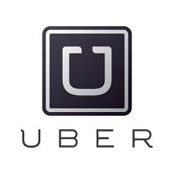
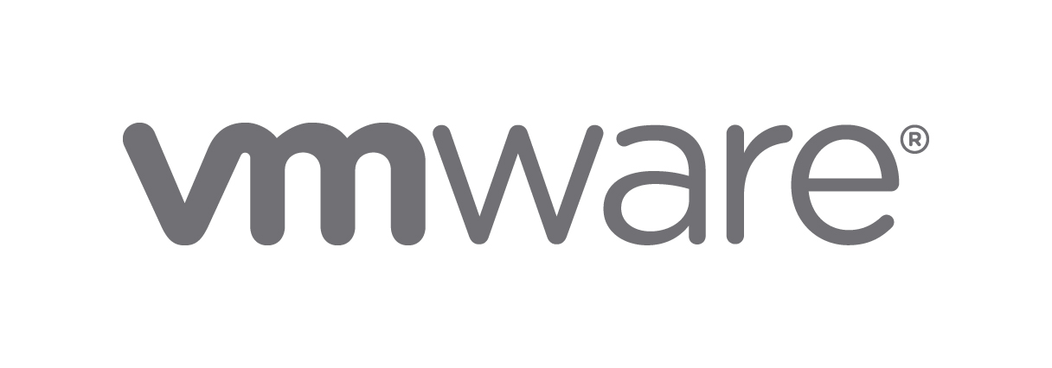
Sample employers who tend to sponsor
Note: Subject to change by company. Companies may also only sponsor by specific job function.
Notes:
Notes: VMware will not accept international students for Corporate roles (e.g. Corporate Development, Strategy, Finance, etc.)

Slide 14
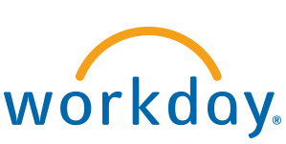
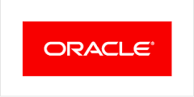
Sample employers who tend NOT to sponsor
Note: Subject to change by company. Companies (Meta, LinkedIn, Intuit) may sponsor by specific job function.
Notes:
Note: For Meta, Intuit, LinkedIn, VMware, they will accept International students for technical roles in People Analytics, Supply Chain, Product Management.

