Slide 1
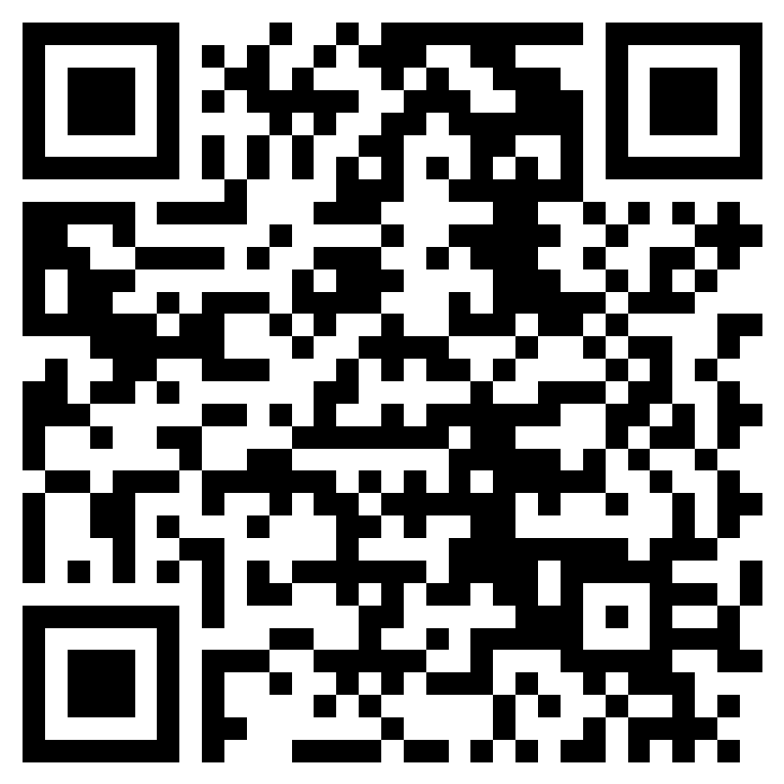
Pathway to CPA
Get all your CPA Exam Questions Answered
5 Key steps to becoming a CPA
Application Process
Eligibility Requirements
Testing Center Do’s and Don’ts
New Exam Structure and Content
Study Tips and Tricks
RSVP
Presented by: Lupe Casillas, Account Manager
Date: Tuesday, February 6th
Time: 12-1pm
Location: N340/N344, Chou Hall, Haas School of Business
Pease RSVP using the QR code or link by February 4th in providing allergies/dietary restrictions.
FREE FOOD
For more information, contact : Kathy Nguyen at nguyenkathy0088@berkeley.edu

