Slide 1
Shaping Expectations &
Enrolling Committed Students
Peter Goodson
Center For Teaching Excellence
Day 2 8:30-9:45 am
S480
“Well, class, now that we can agree on the work load this term”

Slide 2
Overview
Goodson’s Bias and Discussion Caveats
Goodson’s Bias
The first class is the only time where …
course expectations are shaped
conditions are agreed to
student decides to enroll or opt out for another course
A time for candor and clarity as my course is not for everybody
The vast majority of Hass students crave to …
be challenged
be worked hard
maximize the return on their investment
further their career perspective and skill sets
A minority of underachievers or poorly motivated students …
should not lower the teaching standard at all and be politely tolerated…
focus on those that invest in the learning and discourage the rest from taking the course
We owe he students a chance to withdraw if the fit is not right…
I am brutally candid as to the course shortcomings
stress the heavy work load per unit
hammer the very tough rules of the road
Want a friend buy a dog. Respect comes from delivering value in the classroom
Discussion Caveats
Comments are aimed at electives, probably to tough for core cores as the students have to take the offering without choice
Assume that the course is test marketed carefully and designed to be a popular elective (if not, redesign it)
Assumed that the teacher would be effective at pre- marketing course
Pardon the typos and grammar

Slide 3
Overview
Today's Agenda… The Five C’s
1. Clarity:
Who the course is designed for?
What the course is and what it is not.
2. Challenge:
A 3 unit work load for a 2 unit course delivers high value but at a cost.
3. Conditions of Enrollment:
The rules are the rules- be clear on the way the class works
4. Class Room Confrontation:
Training in the real world atmosphere ….demanding classroom tension
5. Open Criticism Of The Course:
Enrollment insight from negative student comments from past evaluations
3

Slide 4
Clarity:
Course Is Aimed at Future Decision Makers
The class is taught primarily for students who want to be decision makers whose career aspirations include…
Top level executive positions (CEO, CFO),
Partner in a M&A advisory firm- investment bank
Partner in a management consulting firm
Partner in private equity firm
Entrepreneur or start up founder
Partner in venture capital firm

Slide 5
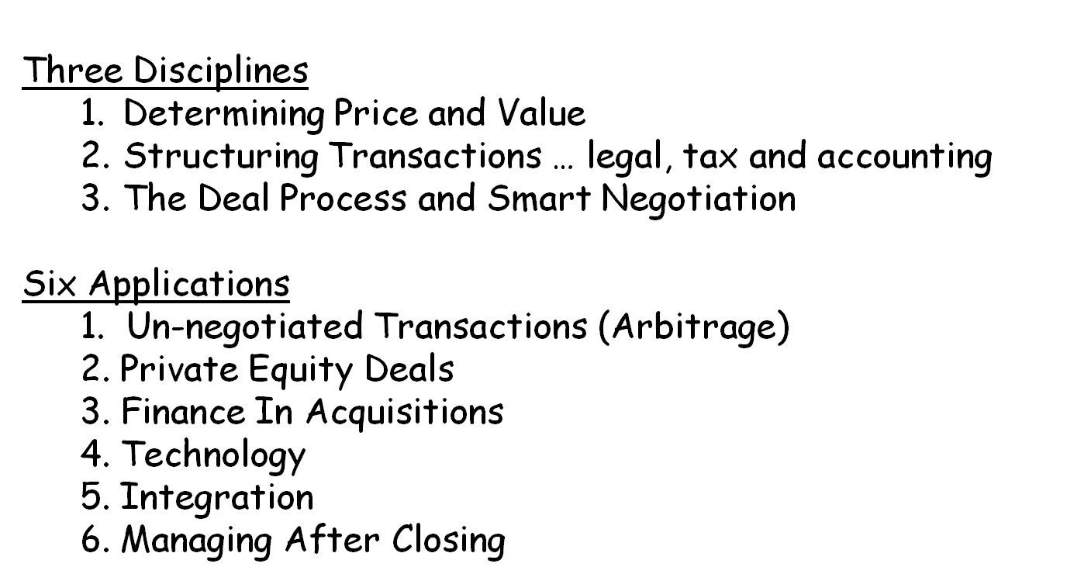
Overview
Clarity…
Survey Course Organized Into Stand Alone Disciplines And Applications
It is a survey course covering 9 topics, each of which could be taught as an entire course. Topics are divided into disciplines (basics )and applications…
Each topic is discreet and much of the value of the course is provided in classroom interaction
Attendance of all sessions is therefore critical
5
Notes:
5

Slide 6
Clarity:
Deliverable In Terms Of Career Perspectives & Skill Set
The career benefit of the course is to offer experience-based lessons to enhance the students ability to create shareholder value and avoid costly pitfalls in buying and selling businesses!
The course design is aimed at…
  Developing judgment …Sharing lessons in distinguishing practices that create value from those that result in loss
  Exploring leadership …Directing an insightful acquisition process geared to mitigate risk in order to capture return followed by lessons in managing after closing to operationally improve the results of the acquired business
  Polishing acquisition negotiation-related skills …Capturing the advantage in the tradeoffs inherent in doing a deal and in establishing a win-win scenario with the CEO and top managers of the acquired company after the transaction has been completed
6
Notes:
6

Slide 7
Clarity:
The Course is not a Bunch of Canned Formulas Nor A List of Equations That When Applied Produce Value
We provide practical approaches to problem solving in ambiguous settings as well as leadership practices that have proven to be successful in the real world
The “human factor” is dominant, the variables independent, and logic is frequently trumped by blind ambition and/or self-interested advisors.
This is not a corporate strategy course analyzing business combination rationale slogans but rather focusing on measures that create incremental shareholder value in measureable terms.
It is a domain where learned experience proves to be much more valuable than textbook niceties.
Therefore, sharing the hard earned lessons gained by the Professor in participating in thousands of mergers and acquisitions over the last forty years is a course cornerstone.
In this field, the most important insight is to teach you to know what to do when you don’t know what to do.

Slide 8
Clarity:
Tutorial for M&A and Turnaround Course Slides
High Level “Slide Reports” for Owners, Chief Executives and Boards of Directors
We like to call the assignment slides in our courses “slide report's” rather than presentations. There are many different types of slide “shows” aimed at different audiences and for different purposes. In our courses the format is along the lines of what a management consultant like Bain would use to inform rather than persuade. Note that the presentations when read would not need a spokesperson. They are clear without an oral presentation.
In this Tutorial we will outline the concepts below, format tips and provide examples to demonstrate what we are looking for . The last slide is a graded slide that was poorly done which includes correctional comments. Below is a conceptual outline :
  Meaningful Slide Heading: A opening statement or conclusion followed by the key conditions necessary for the statement to be correct. An example… “The acquisition of XYZ for $20-$25 a share will add 15% or more shareholder value if operating improvements doubling EBIDTA can be delivered in 5 years”. It is an anchoring statement for the audience. It must deliver the key advantage and state what must be done or the risk in achieving the result.
  2. Primary Supporting Points: Notice that on each example slide there are three to five points that support the slide heading. Each supporting point is clearly stated and not abbreviated. If you were to read the heading and then the supporting points together, the students’ position would be clearl without detail to verify.
  3. Detail Verifying the Supporting Points: Under each supporting point is the detail that justifies the conclusion of the supporting point. We encourage students to embellish detail with imaginary knowledge not contained in the case. The governing point is that the logic of the detail must link into the supporting point. HBS cases in particular can be a little broad brush so we want you to be creative as to what other information, had it been available, that you would have included and invent theoretical detail points that you view would be critical to your analysis even though these facts might not be available in the case.
Slide Format: Teaching Team– Peter Goodson, Paul Mackinaw

Slide 9
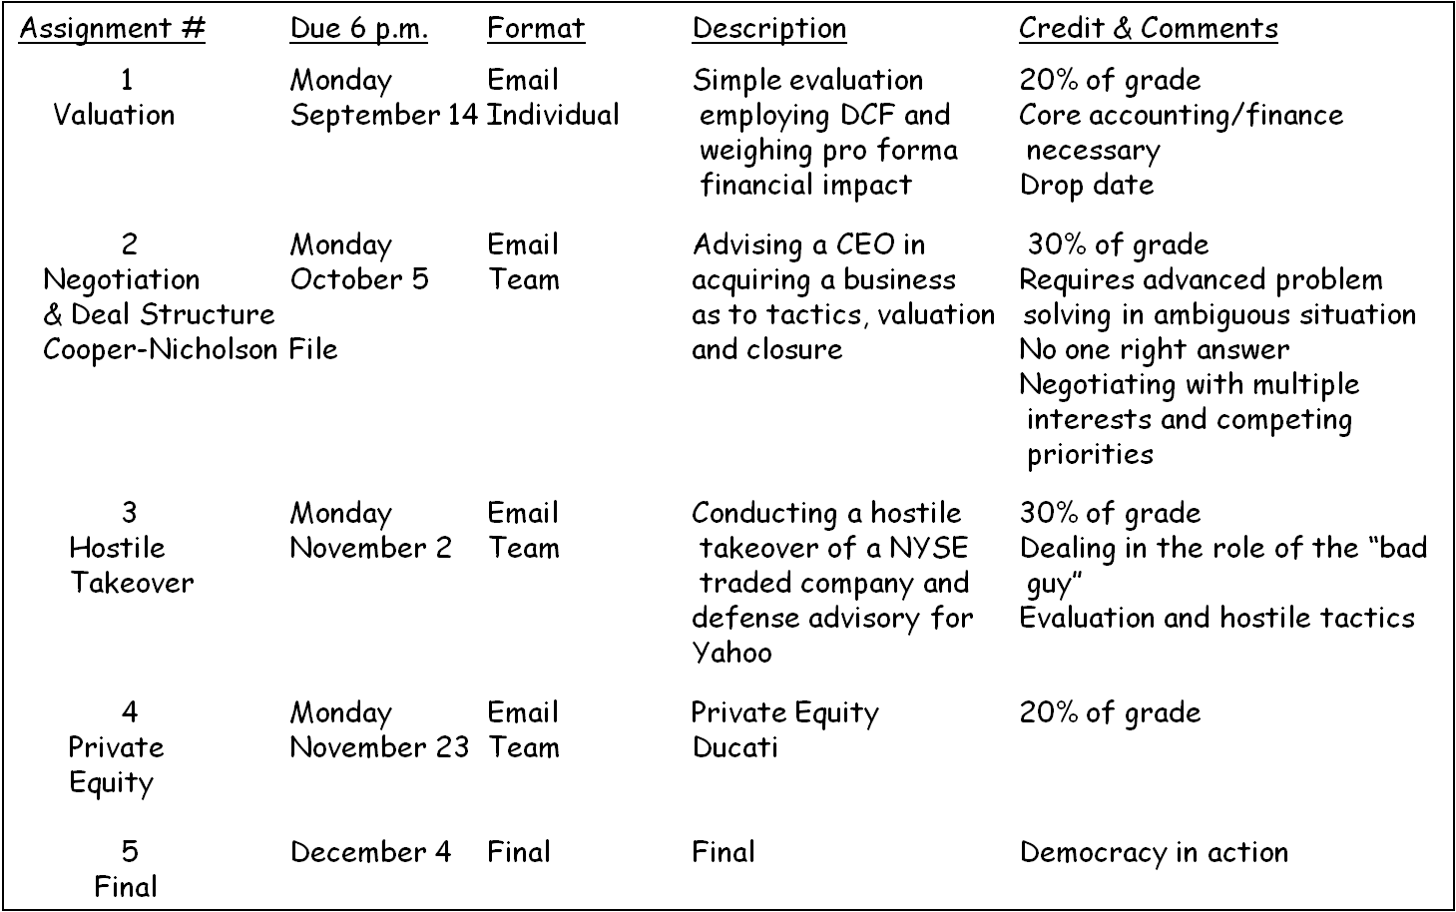
Challenges:
A 3 Unit Work Load In A 2 Unit Course Delivers High Value
But Demands A Significant Investment of Your Time
To deliver the full course value a serious time commitment is necessary
4 cases… 3 of which students present in class
3 additional case studies to be discussed in class and students are intensely grilled
“This course is a little like drinking from a fire hose in its breadth and velocity” … A former student
9
Notes:
9

Slide 10
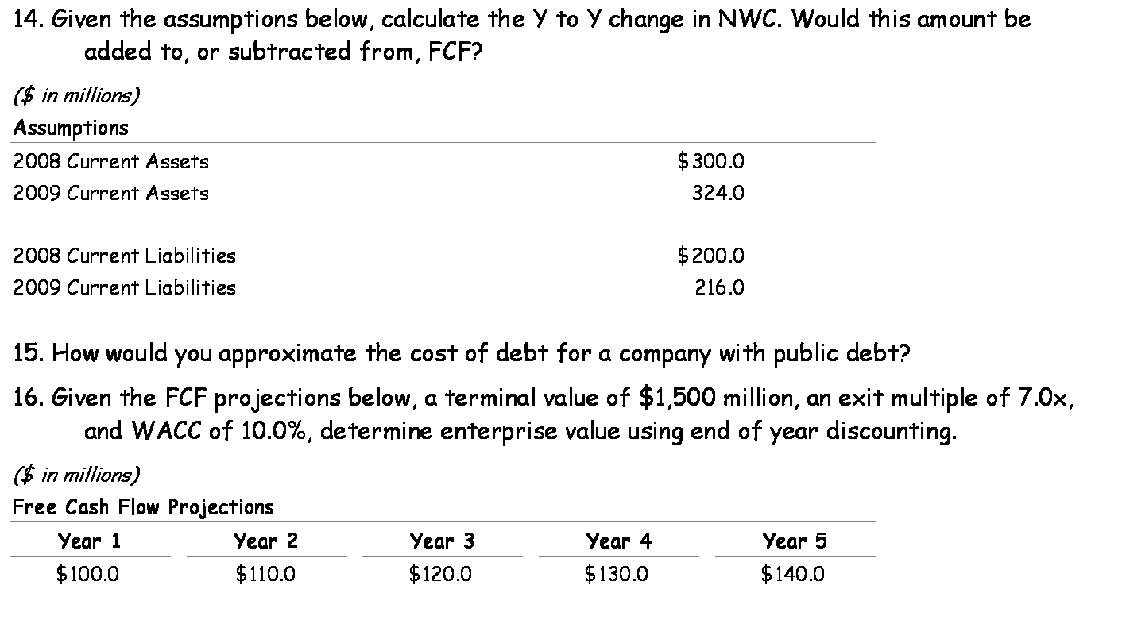
Challenges:
Cold Calls And Consequences
I give students “cold calls” in advance so there is focus on what we want them to specifically master in the reading material.
Everybody uses cold calls so what is different than some in my class is what happens if the student is not prepared.
It been expressed by former students that being unprepared is a highly uncomfortable experience in front of your peers
I then role play a unprepared response with a student shill… Silly but
very effective and rarely do we find an unprepared student
going forward

Slide 11

Conditions of Enrollment:
The Rules Are the Rules- Be Clear on the Way the Class Works
No Such Thing As A Late Assignment...any assignment turned in late results in a failure and will not be graded. There are no exceptions.
3 On A Team… free riders will balk but you will learn more. Time tested. Not optional!
Not A Correspondence Class… individual answers from the GSI’s are not given. We organize a web spot and answer questions collectively and share with the whole class… adds value… trust us
No Computers or Cell Phones …the PowerPoint's provide ample notes; computers are not allowed in class nor are cell phone calls
Name Plates Required…to better personalize a large class, enable cold calls and comfort for visiting speakers each session
Be On Time… be in your seat at the beginning of class or wait to rejoin at the break. We take the view that it is a requirement to be prompt in most workplaces so we shouldn’t give you bad habits here
Attendance Required… be here - much is taught via the case method and the value is in person exchange . Two unexcused absences carries a huge penalty

Slide 12
Class Room Confrontation:
Training in the Real World Atmosphere …
Instructive Classroom Tension
Settings And Styles Vary... But one of the distinctions in this course is that three assignments are framed in a way that the student is the advisor or principal making a case in a presentation either for or against a deal.
Context…. The audience is either a CEO, a board or a group of investors. Realize that outside advisors usually face tension packed settings where their findings are openly and forcefully challenged.
Intellectual Tension …We create a tension by training your peers to drill down on the supporting logic of your point of view. When you are not thought-out it becomes very obvious.
Conflict at Haas… This style of active interrogation and free for all argument is not often experienced in the Haas environment. Students seem uncomfortable in navigating a seemingly "aggressive" atmosphere. Hence we give them some practice at real world disputes involving big money and huge stakes.

Slide 13
Criticism:
Professor Too Tough On Students In Front Of Peers..
Slides Too Crowded … Lectures Loaded With M&A Slang
Student Quotes From Actual Evaluations
“Embarrassing students who were not prepared was not necessary” (2008)
“Too much information on slides which made following the lecture difficult” (2004) and “frequently flipped through slides too rapidly” (2004)
“The jargon of the industry was particularly difficult to comprehend as it was very different than the academic vocabulary of most classes” (2004)
“The American slang was very difficult to follow for an International student” (2005)
On the other hand …
“Wish more professors were openly tough on the unprepared … we pay too much to put up with someone who has not read the material and wants us to slow down or wants to shift topic and tell us how great they are” (2009)
“Unique opportunity to understand how practitioners refer to their trade” (2004)
“Slides were a great resource of information distinguishing concepts on a standalone basis” (2005)

Slide 14
Student Quotes From Actual Evaluations
Criticism:
Not Much Hand Holding On Assignments
“Did not provide detailed step-by-step instructions for assignments” (2009) and “Not obvious how to do projects” (2004)
“Could have spent more time teaching modeling” (2004)
“Did not walk through the ‘details’ of any of the assignments” (2008)
On the other hand …
“If you like formulas and step-by-step certainty, this course is not for you”
“If you like advanced problem solving and tackling ambiguity as it exists in deal making in the real world, get comfortable and stay a while … great course for the top executive/ownership aspirant” (2005)

Slide 15
Criticism:
More Breadth Than Depth & Very Fast Paced
Student Quotes From Actual Evaluations
“Would have been great to have as a three-unit course” (2004) and “I would have loved to have another five weeks” (2005)
“Moved over some questions too fast and sometimes glossed over material leaving us to read from the text” (2010)
On the other hand …
“If you didn’t get Core Finance and Accounting when you took it and struggled with simple modeling, this course will be tough” (2004)
“Loved the pace … fast and furious … don’t slow down with irrelevant questions from students speaking without preparing” (2005)
“Got much out of the time at Henry’s asking ‘ad nauseum’ [sic] questions after class … unique experience to provide those with interest to unlimited access to Professor” (2005)
“Each topic could have been a course … you cut to the chase – great overview!”

