Slide 1
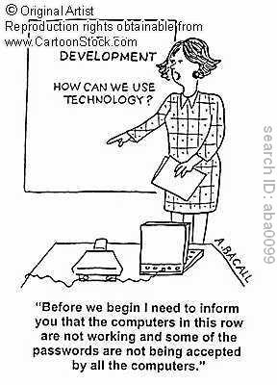
Technology and Teaching

Slide 2
Seminar Goals
Demonstrate four different technologies that can be used to engage students
  i<clicker
  Power Point
  Video
  Drawing
Provide new methods to enhance learning for the millennial generation!

Slide 3


i<clicker
Why use?
Gets students involved
Tests understanding
Allows for real opinions
Tracks attendance
Other
Prepared slides vs. polling
Buy vs. borrow

Slide 4
Test Yourself Q1
A= positive; B = negative; C = extinction; D= punishment
Q1: Employee whines about the sales quotas to colleagues and is ignored
Q2: Employee receives a reward for making a certain number of sales
Q3: Employee falls below sales goals and is required to meet with the sales manager daily or is reprimanded
Q4: Employee meets sales quotas and is no longer required to meet with the sales manager daily or gets reprimanded

Slide 5
Equity Theory: Part I
O
I
= Underpayment Inequity
O
= Overpayment Inequity
I
O
O
= Equity =
I
I

Slide 6
Person
A
Social
Comparison
Person
B
Less
Than
O
Overpayment
inequity
for Person B
O
I
I
Equity Theory Part II
More
Than
O
I
O
Underpayment
inequity
for Person B
Angry
I
Equal
To
O
I
O
I
Equitable
payment
for Person B
Satisfied
Satisfied

Slide 7
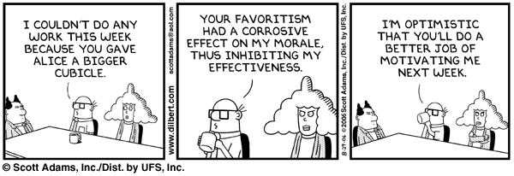
The effect of Inequity on Motivation
Inequity of Resources

Slide 8
Test Yourself Q3
Jamie discovers that he is paid substantially more for proof reading legal documents than his colleagues, even though their jobs and performances are very similar. According to equity theory he is likely to
A = decrease the amount of documents he reads
B = decrease the quality of documents he reads
C = increase the quantity or quality of documents he
reads
D = he will leave his job
E = there will be no effect

Slide 9
Example of Testing for Comprehension –Sequence

Slide 10
Problem 1a
Mark is finishing his MBA at a prestigious
university. He is very interested in the arts and at one time considered a career as a musician. Is he more likely end up with a job in?
A = a management consulting firm?
B = the management of the arts?

Slide 11
Representative Heuristic
Making a judgment based on the resemblance to a typical case while ignoring information about averages or prior probabilities

Slide 12
Problem 1b
If I were to toss a coin eight times,
which of the following sequence of
coin flips is more likely?
A = TTTTTTTT
B = TTTTHHHH
C = THTTHHHT

Slide 13
Gambler’s Fallacy
“Law of Small Numbers”
The belief that data collected by a random process will look random; however, the sequence collected is too short for the process to express itself statistically

Slide 14
Problem 1c
A town is served by two hospitals. Approximately 45 babies are born in the larger hospital and 15 babies are born in the smaller hospital each day.
About 50% of all babies are boys but the exact percentage varies from day to day.
For a period of one year, each hospital recorded the days in which more than 60% of the babies were boys.
Q: Which hospital do you think recorded more such days? <Click in>
A= The larger hospital B=The smaller hospital
C= About the same

Slide 15
Representative Heuristic: Biasing Factors
Not sensitive to statistical information
Not sensitive to sample size
Misconceptions of chance

Slide 16
Vote for the BEST presentation
Group 1
A = Little Black Dress
B = Mandex
C= Relaxitrain
D = Lightning
Group 2
A = Swish
B= Manny hose
C = Trax
D = Bronze

Slide 17
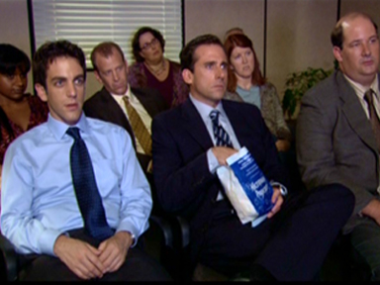
Using Videos
Demonstration
Integration/Playback (Real Player, DVD, Videolinks, Embedded)
How to use
Purpose (case or application)
Length
Content
Sources
Age of video
Added value
Copyright issues

Slide 18


Videocase: Zappos and The Millennials
Adapt your management style for different generations
Coaching is a useful motivational tool (vs. giving directives)
Recognize and reward where you can
Having a fun workplace can help attract/retain employees
Show You Value Your Employees

Slide 19
Using Powerpoint
How to use—key points on slides
  Avoid clutter
  Don’t use as lecture notes
  Consider using “take-away” handout for details
Careful material not too redundant with book
Use of a remote/use B-Key
Q: Should I post before or after lecture?

Slide 20
Gender Differences in Communication
Table 14-4
Example of
Poor Quality
Men are less likely to ask for information or directions
In decision making, women are more likely to downplay their certainty; men are more likely to downplay their doubts
Women apologize even when they have done nothing wrong. Men avoid apologies as signs of weakness or concession
Women accept blame as a way of smoothing awkward situations. Men ignore blame and place it elsewhere
Women temper criticism with positive buffers. Men give criticism directly. Women insert unnecessary and unwarranted “thank-you’s” in conversations. Men avoid thanks altogether
Women ask “What do you think?” to build consensus. Men perceive that question as a sign of incompetence and lack of confidence
Women give directions in indirect ways
Men usurp (take) ideas stated by women and claim them as their own. Women allow this process to take place without protest
Women use softer voice volume to encourage persuasion and approval. Men use louder voice volume to attract attention and maintain control

Slide 21
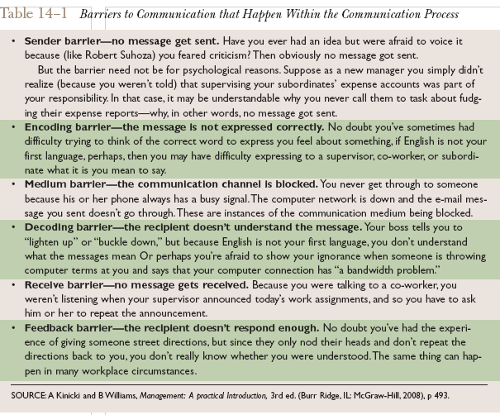
Process Barriers to Effective Communication
Example of Poor Quality

Slide 22
Interesting OB Dependent Variables
Productivity
  Transforming inputs to outputs at lowest cost. Includes the concepts of effectiveness (achievement of goals) and efficiency (meeting goals at a low cost).
Absenteeism
  Failure to report to work – a huge cost to employers.
Turnover
  Voluntary and involuntary permanent withdrawal from an organization.
Deviant Workplace Behavior
  Voluntary behavior that violates significant organizational norms and thereby threatens the well-being of the organization and/or any of its members.
Example of
Poor Quality

Slide 23
Typical OB Dependent Variables
Productivity
  Effectiveness—achievement of goals
  Efficiency –meeting goals at a low cost
Absenteeism
Turnover
Deviant Behavior
  Theft, sabotage, aggression
Poor Quality Slide Revised

Slide 24
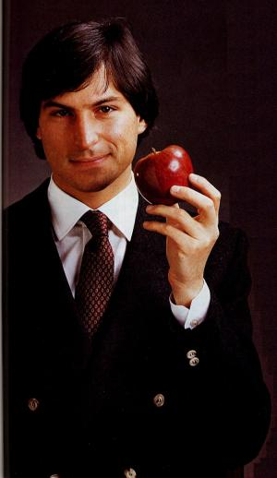
Charismatic Leader Behaviors
Articulates overarching goal-vision
Communicates high performance expectations
Exhibits confidence and enthusiasm in the ability of followers to meet expectations
Empathizes with the needs of their followers
Uses whole body when speaking-paces, sits on desk edge, leans forward, eye contact, relaxed posture & animated face
Captivating and engaging voice tone

Slide 25
Myers-Briggs
T
F
Makes decisions by stepping out of the problem to be objective
Makes decisions by stepping into the problem to be compassionate
Notes:
Thinking is about ‘stepping out’ of the problem.
Feeling is about ‘stepping into’ the problem.

Slide 26
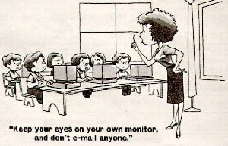
Computers in the Classroom
Set a computer policy
Pros and cons

Slide 27
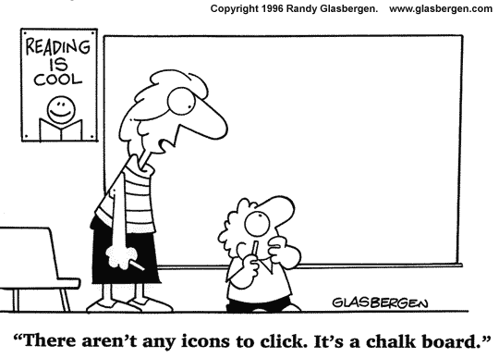
Thank You
schroth@haas.berkeley.edu

